Slide 1
CSE 12 – Basic Data Structures and Object-Oriented Design Lecture 18
Greg Miranda & Paul Cao, Winter 2021
This lecture is being recorded

Slide 2
Announcements
Quiz 18 due Monday @ 8am
Survey 7 due tonight @ 11:59pm
PA7 due Tuesday, March 2nd @ 11:59pm
Exam 2 – Week 8
Released Friday 2/26 @ 8am
Due Saturday 2/27 @ 10am
Topics:
Cumulative
Big topics
Big O, Big Theta run-time analysis
Sorting algorithms
Hash tables/maps

Slide 3
Topics
Questions on Lecture 18?
Binary Search Trees

Slide 4
Tree
12
root
left child
right child
20
7
The height of a binary tree is the largest number of edges in a path from the root node to a leaf node.
height
9
99
-6
leaf
leaf
22
leaf
Binary Tree: a node may have at most 2 children

Slide 5
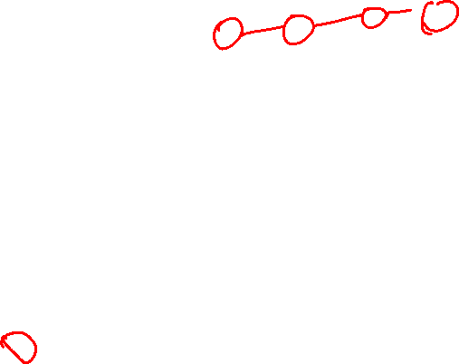
Tree Node
class TNode{
________ left;
________ right;
Integer value;
}
What should be the type of left and right?
Integer
Object
TNode
Anything that implements Comparable interface
Something else

Slide 6

Tree
What methods we should NOT put into the TNode class?
getLeftChild
getValue
setValue
setRightChild
getRoot
class TNode{
TNode left;
TNode right;
Integer value;
}
It is fairly similar to linked lists except we have two children

Slide 7
BinaryTree Class
public class BST
{
/** Inner class*/
class TNode {
TNode left;
TNode right;
Integer value;
public BSTNode(Integer value)
{
this.value = value;
}
}
BSTNode root;
int size; //number of nodes in the tree int height; //height of the tree
root
42
size = 5
height = 2
32
65
30
38

Slide 8
Binary Tree Contains: Let’s write it!
// Return true if toFind is in the Tree. We will use recursion here
public boolean contains(Integer toFind) {
root
22
32
25
30
11

Slide 9
Binary Tree Contains: Let’s write it!
// Return true if toFind is in the Tree. We will use recursion here
public boolean contains(Integer toFind) {
root
contains(32)?
22
32
25
30
11

Slide 10
Binary Tree Contains: Let’s write it!
// Return true if toFind is in the Tree
public boolean contains(Integer toFind) {
//RECURSION!
return containsHelper(root, toFind);
}
// This recursive method returns true if toFind is in the
// tree rooted at currRoot, and false otherwise
private boolean containsHelper(TNode currRoot, Integer toFind)
{
// To write!
}
root
contains(32)?
22
32
25
30
11

Slide 11
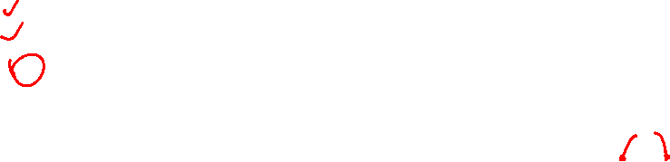
Binary Tree Contains: Let’s write it!
// Return true if toFind is in the Tree rooted at currRoot,
// false otherwise
boolean containsHelper(TNode currRoot, Integer toFind) {
Base case(s): When do we know we are done?
toFind is less than currRoot’s element
toFind is greater than currRoot’s element
toFind is equal to currRoot’s element
currRoot is null
More than one of these
root
22
32
25
30
11

Slide 12
Binary Tree Contains: Let’s write it!
// Return true if toFind is in the Tree rooted at currRoot,
// false otherwise
boolean containsHelper(TNode currRoot, Integer toFind) {
Base case 1: (sub)tree is empty, so we know toFind is not in it
root
22
32
25
30
11

Slide 13
Binary Tree Contains: Let’s write it!
// Return true if toFind is in the Tree rooted at currRoot,
// false otherwise
boolean containsHelper(TNode currRoot, Integer toFind) {
if (currRoot == null) return false;
Base case 2: toFind is found
We will roll this in with our recursive step
So what is our recursive step…?
root
contains(32)?
contains(65)?
contains(42)?
contains(40)?
22
32
25
30
11

Slide 14
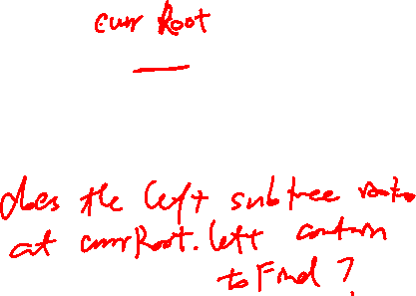
Binary Tree Contains: Let’s write it!
// Return true if toFind is in the Tree rooted at currRoot,
// false otherwise
boolean containsHelper(TNode currRoot, Integer toFind) {
if (currRoot == null) return false;
Base case 2: Element is found
We will roll this in with our recursive step
So what is our recursive step…?
contains(32)?
contains(65)?
contains(42)?
contains(40)?
42

Slide 15
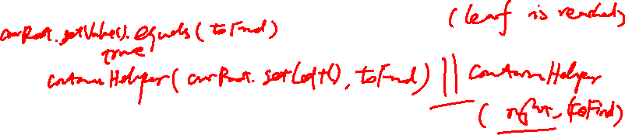
Binary Tree Contains: Let’s write it!
// Return true if toFind is in the Tree rooted at currRoot,
// false otherwise
boolean containsHelper(TNode currRoot, Integer toFind) {
if (currRoot == null) return false; // first base case
if (______________________) //second base case
return __________________
return __________________________________________
contains(32)?
contains(65)?
contains(42)?
contains(40)?
Recursive step and base case 2
Fill in the blanks above.
If you need another hint, check out the next slide.
42

Slide 16
DFS approach using a stack
// Return true if toFind is in the Tree rooted at currRoot,
// false otherwise
boolean containsHelper(TNode currRoot, Integer toFind) {
if (currRoot == null) return false; // first base case
if (______________________) //second base case
return __________________
return __________________________________________
contains(32)?
contains(65)?
contains(42)?
contains(40)?
Recursive step and base case 2
Fill in the blanks above.
If you need another hint, check out the next slide.
42

Slide 17
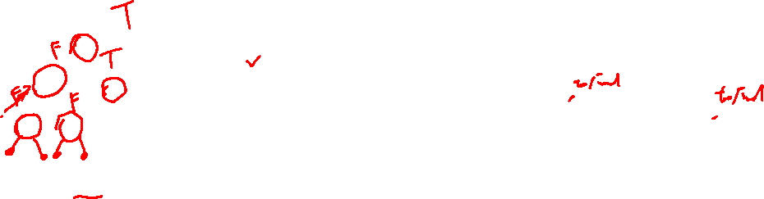
root
// Return true if toFind is in the Tree rooted at currRoot,
// false otherwise
boolean containsHelper(TNode currRoot, Integer toFind) {
if (currRoot == null) return false; // first base case
if (currRoot.value.equals(toFind)) //second base case
return true;
return containsHelper(currRoot.left)
|| containsHelper(currRoot.right);
}
22
32
25
30
11
contains(25)?

Slide 18
root
// Return true if toFind is in the Tree rooted at currRoot,
// false otherwise
boolean containsHelper(TNode currRoot, Integer toFind) {
if (currRoot == null) return false; // first base case
if (currRoot.value.equals(toFind)) //second base case
return true;
return containsHelper(currRoot.left)
|| containsHelper(currRoot.right);
}
22
32
25
30
11
contains(12)?

Slide 19

What is the WORST CASE cost for doing find() in a Tree (tightest Big-O, on this and future questions)?
O(1)
O(log n)
O(n)
O(n log n)
O(n²)

Slide 20
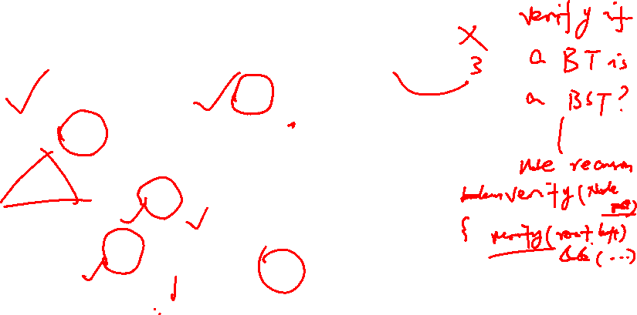
Which of the following is/are a binary search tree?
C.
42
A.
42
B.
42
12
32
65
32
12
55
12
30
38
D.
42
45
32
56
E. More than one of these
12
45

Slide 21
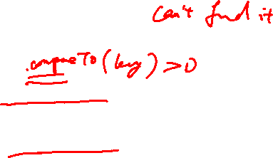
class Node<K,V> {
K key;
V value;
Node<K,V> left;
Node<K,V> right;
public Node(K key, V value,
Node<K,V> left,
Node<K,V> right) {
this.key = key;
this.value = value;
this.left = left;
this.right = right;
}
}
class BST<K, V> {
Node<K, V> root;
BST() (this.root = null);
BST(Node<K, V> root) { this.root = root; }
V get(Node<K, V> node, K key) {
if (node == null) { //throw error }
if (node.key.equals(key)) {
return node.value;
}
if (node.key > key) {
return get(node.left, key);
}
else {
return get(node.right, key);
}
}
V get(Key key) {
return this.get(root, key);
}
}

Slide 22
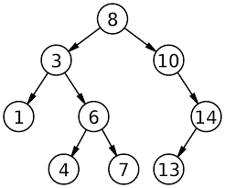

Binary Search Tree
Assume the key and value are identical for this example
Trace the path for get(4)
How many nodes does it touch?
Trace the path for get(2)
How many nodes does it touch?
What happens when the nodes isn’t found?

Slide 23
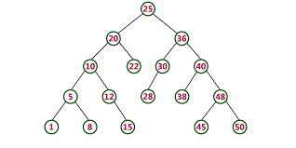
Binary Search Tree
Assume the key and value are identical for this example
Trace the path for get(40)
How many nodes does it touch?
Trace the path for get(4)
How many nodes does it touch?

